Slide 1

Change of Venue!
Due to popularity, this session has
been moved to … Zochonis Lecture
theatre B.

Slide 2
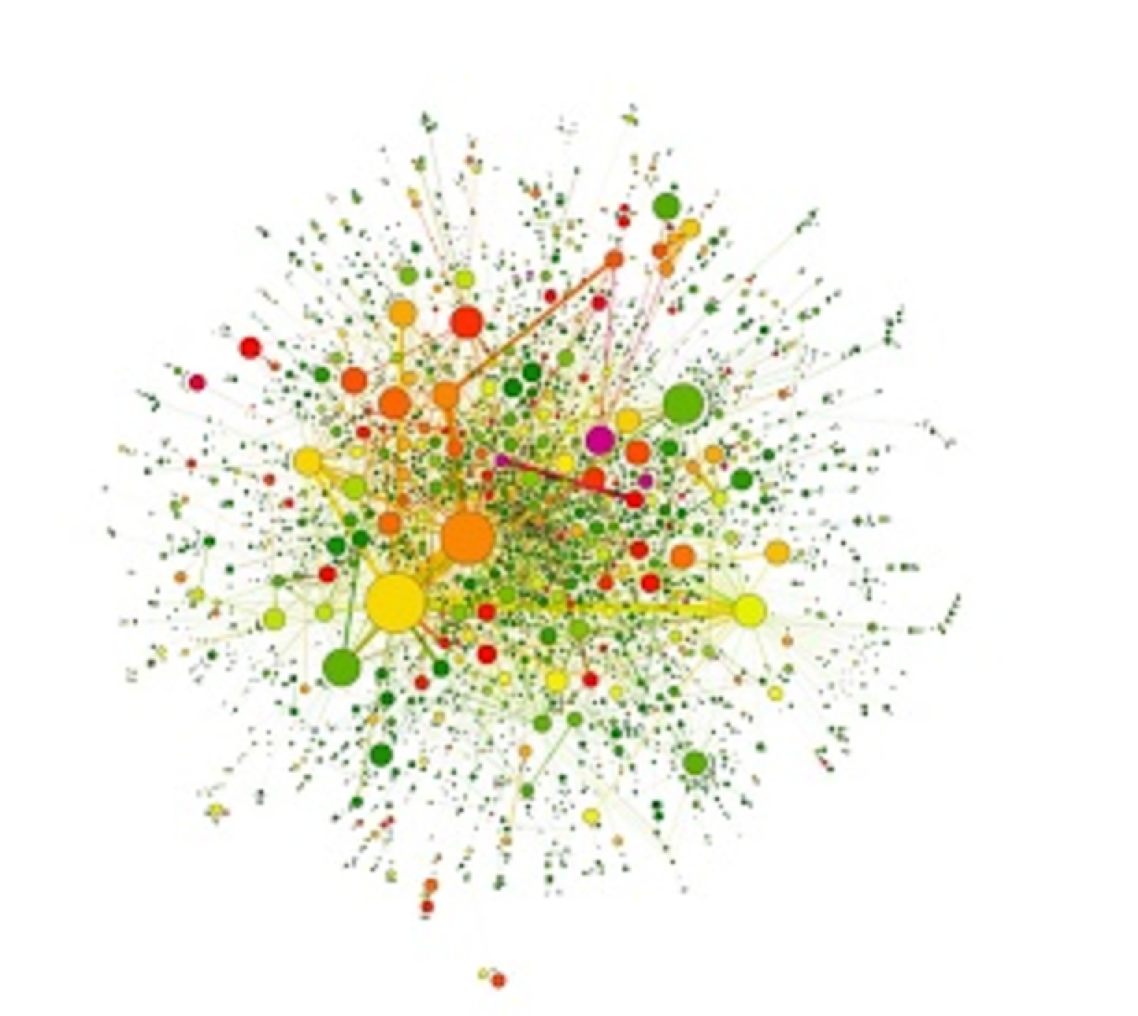
P(egs) bioinformatics for Postgrads
Postgraduate Evolution and Genomic Science Lecture series.

Slide 3
Phylogenetics
Ignacio Riquelme Medina, 3rd year PhD Student
Bioinformatics, convergent evolution
McInerney Lab
Fungi, Phylogenetics, Networks, Coincidence.

Slide 4
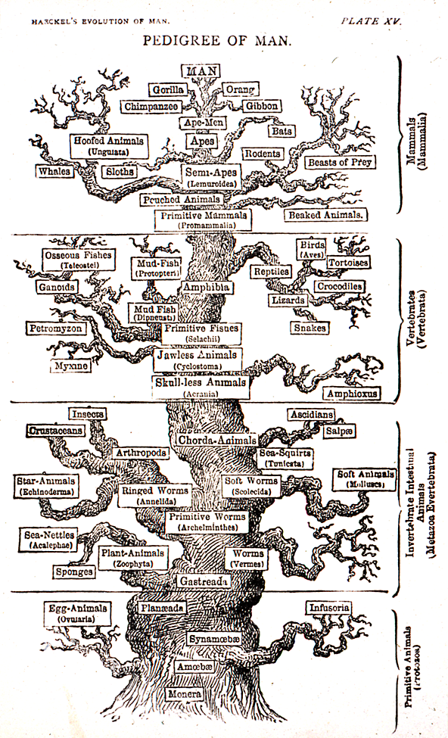
What is phylogenetics?
Sees homology as evidence of common ancestry
Uses tree diagrams to portray relationships based upon recency of common ancestry
Monophyletic groups (clades)
Notes:
Clades contain species which are more closely related to each other than to any outside of the group

Slide 5
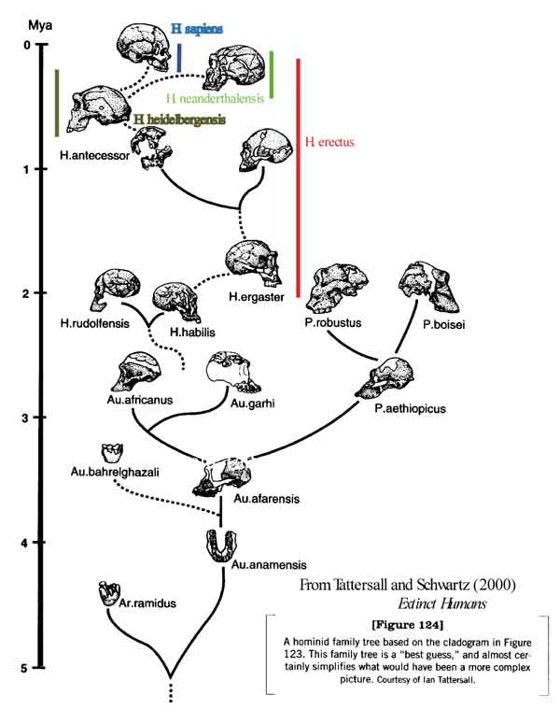
What is phylogenetics?
Phylogenetics can also be used with fossil and morphological data

Slide 6
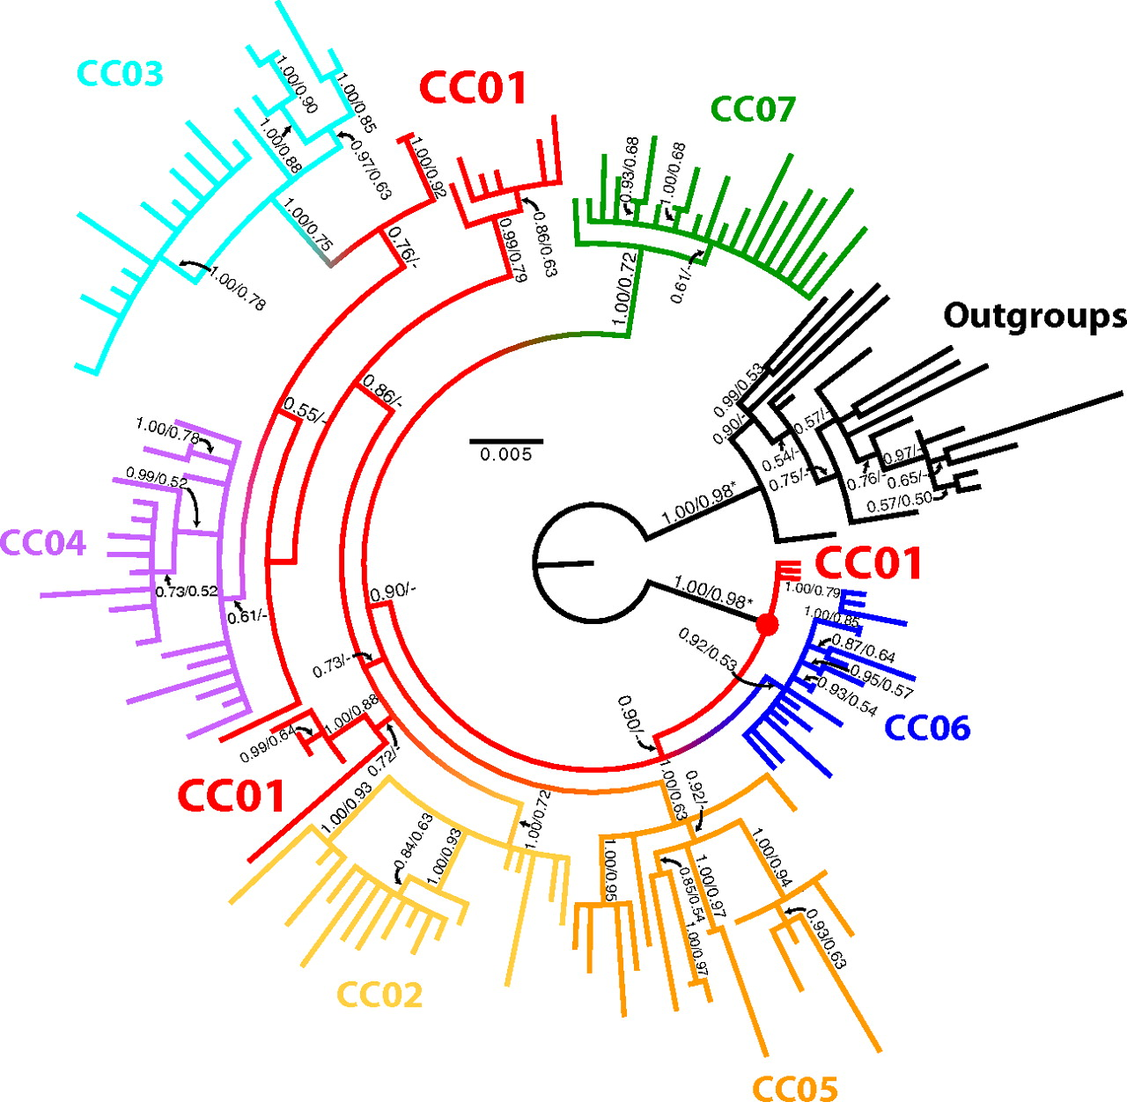
What is phylogenetics?
It is not only used for species, it can also be used for gene families, disease distribution, language evolution…
Notes:
Image was obtained from:
D. I. Scaduto, J. M. Brown, W. C. Haaland, D. J. Zwickl, D. M. Hillis, y M. L. Metzker, «Source identification in two criminal cases using phylogenetic analysis of HIV-1 DNA sequences», Proc. Natl. Acad. Sci., vol. 107, n.º 50, pp. 21242–21247, 2010.

Slide 7
Phylogenetics
General considerations
Data and Alignment
Phylogenetic Analysis:
Neighbor joining
Parsimony
Maximum likelihood
Testing

Slide 8
1. Cladograms and phylograms
Bacterium 1
Cladograms show branching order - branch lengths are meaningless
Bacterium 2
Bacterium 3
Eukaryote 1
Eukaryote 2
Eukaryote 3
Eukaryote 4
Bacterium 1
Phylograms show branch order and branch lengths
Bacterium 2
Bacterium 3
Eukaryote 1
Eukaryote 2
Eukaryote 3
Eukaryote 4
Notes:
Parsimony does not provide us with branch lengths. On the other hand Neighbor joining, maximum likelihood and Bayesian inference (not covered in this lecture) do calculate branch lengths.
If you need more tips about reading phylograms you can check this site (https://evolution.berkeley.edu/evolibrary/article/0_0_0/evotrees_primer_08)

Slide 9
1. Rooting and outgroups
archaea
eukaryote
archaea
Unrooted tree
archaea
eukaryote
eukaryote
eukaryote
bacteria outgroup
Tree rooted by outgroup
archaea
archaea
Monophyletic group
archaea
eukaryote
eukaryote
Monophyletic
group
root
eukaryote
eukaryote
Notes:
The root should be closely related to the species or genes we are interested in but outside the groups we will be using to make our tree.

Slide 10
1. Exhaustive vs Heuristics
Exhaustive search considers every possible tree. Good for very small trees.
Heuristic searches many trees by making random changes to our tree. Several algorithms, good for anything but small trees.
Notes:
Some of the programs mentioned in the lecture have the option to do an exhaustive search, but most of them work with heuristics.

Slide 11

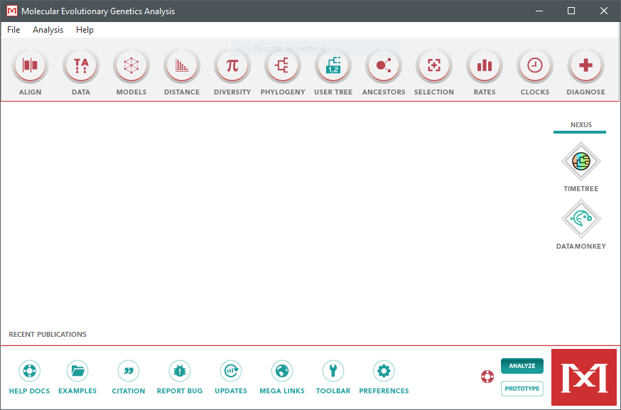
1. Programs to use
Many options for every step of the analysis.
Most of them do not have user interface
In this lecture we will use MEGA (https://www.megasoftware.net/) which has a pretty user interface
Notes:
Mega includes 2 alignment algorithms (ClustalW and Muscle), allows for all the phylogenetic analyses that will be discussed in this lecture (so all but Bayesian inference) and allows us to use Bootstrap to test our models. Other options will be given at the end of the lecture.

Slide 12
2. What data should I use?
DNA for closely related species since it changes more over time (specially the 3rd codon)
AminoAcids for distant species, since it changes less over time.
Remember outgroups
Consider genes or proteins common to all the species in our tree.
Careful with conserved or hyper variable regions.
Use more than 1 gene/protein, can be concatenated.
Notes:
Generally we want to select as many genes as we can that are common to all our species, if they are closely related we should choose DNA avoiding conserved genes since they do not change enough to provide the phylogenetic methods with information on how to split them. Examples of this are gene families, sub species trees, trees of the same genus or family…
On the other hand more distantly related species we should use AminoAcid data selecting common proteins found in all our species (in this case we can consider using conserved proteins, depending on the distance between the species in some cases we can only use conserved proteins) since in long distances DNA can have so many changes that they appear to be random. Some examples of this are making trees of a kingdom or between several kingdoms.
This cases are only meant for guidance and they shouldn't be taken as absolute, each tree should be considered individually for the best data and the best method.

Slide 13
2. Alignments
Starting point: Fasta file with our concatenated sequences, one sequence per species/gene/…
Phylogenetic analysis measures changes in similar regions of the gene/protein.
To correctly order these regions sequences MUST be aligned.
Gene1 Gene2 Gene3
Fasta file:
>Species 1
ATTCGCGCTATCAT
>Species 2
ATTCAGCGGTAAC
>Species 3
GATTGCCTATC

Slide 14
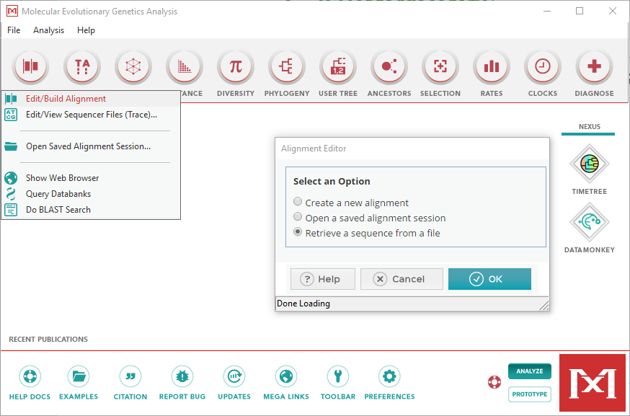
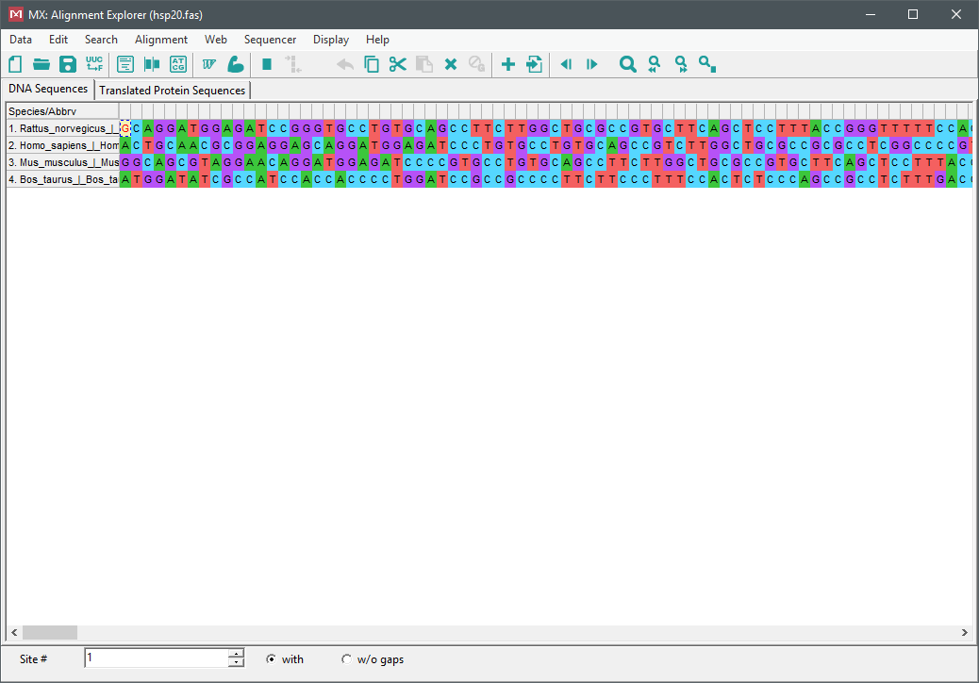
2. Alignments
Notes:
In this lecture we assume that you already have your sequences in a fasta file. However MEGA also allows you to concatenate sequences [In the main MEGA screen, click Data -> Concatenate Sequence Alignments] (basically copy and paste one gene after the other) and import single sequence files, which the program will merge [In the alignment viewer, Edit -> Insert Sequence from file], if you prefer.

Slide 15
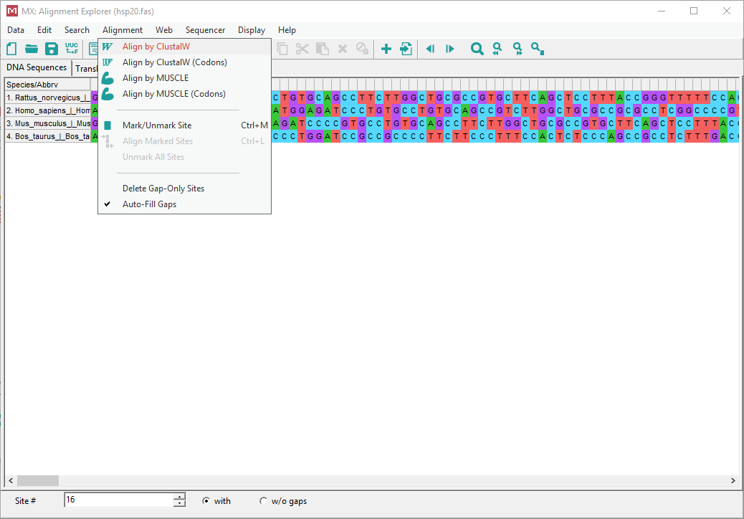
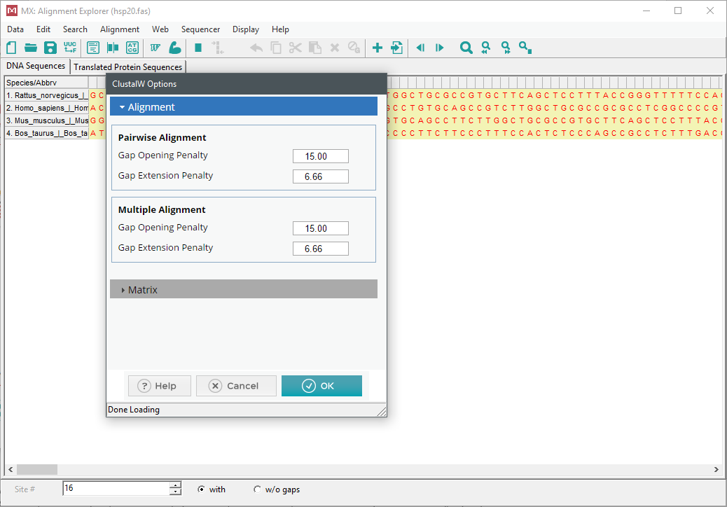
2. Alignments
Notes:
In this lecture we assume will use ClustalW for alignments, but MUSCLE is also fine. You can check both options and see which alignment you like better, but they should be very similar. As for each algorithm options usually default options are a good middle point for every sequence. Both algorithms work for nucleotide and aminoacid sequences.

Slide 16
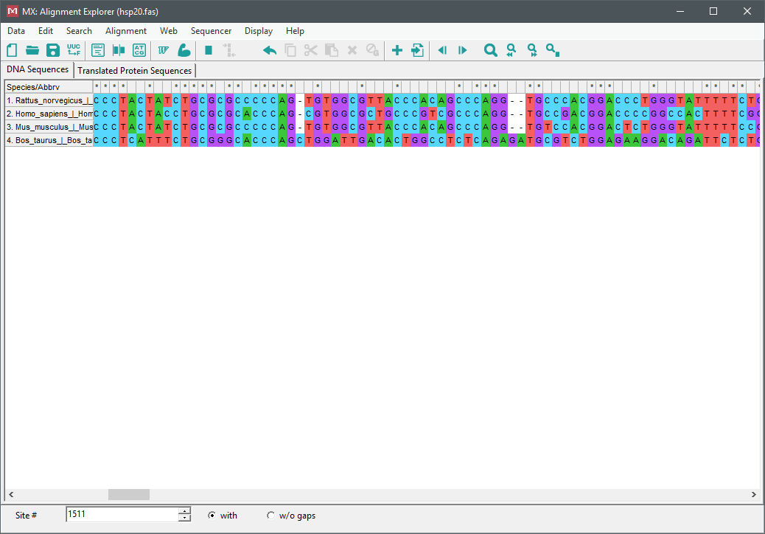
2. Alignments
Gene1 Gene2 Gene3
Fasta aligned file:
>Species 1
-ATTC-GCGCTATCAT
>Species 2
-ATTCAGCGGTAAC--
>Species 3
GATT--GCC-TATC--
We can now save the alignment, it will be used for the phylogenetic analysis. It is recommended to use fasta format.
Notes:
If we plan to continue using MEGA saving the alignment in MEGA format is fine, but if we plan to use any other program for the phylogenetic analysis we should use fasta since fasta is a widely accepted format amongst all the different programs. Either click the save icon to save to MEGA format or Data -> Export Alignment -> Fasta Format.

Slide 17
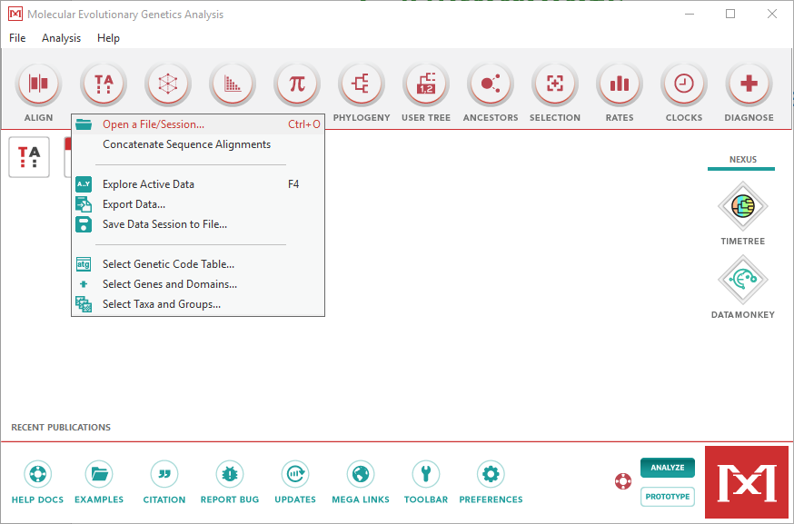
2. Alignments
Load our aligned sequences in the main screen.
Can be used for other programs.
For fasta files we select “Analyze”

Slide 18
3. Neighbor Joining
Properties
Uses
It is a clustering algorithm, i.e. it is just joining similar species together.
Relies on evolutionary distance.
Extremely fast.
Not as reliable or accurate as the other methods.
Used to make very fast trees, usually for other methods that require a starting tree.
Still used in some cases like outbreaks when we need a tree as soon as possible even if it is not accurate.
Notes:
This method uses a very simple model of evolution. Although it can give us the correct tree, this method is not as accurate or reliable as any of the others. It is often not accepted for publication. There are new and improved Neighbor joining algorithms like QuickTree, but it is still not recommended for publication.

Slide 19
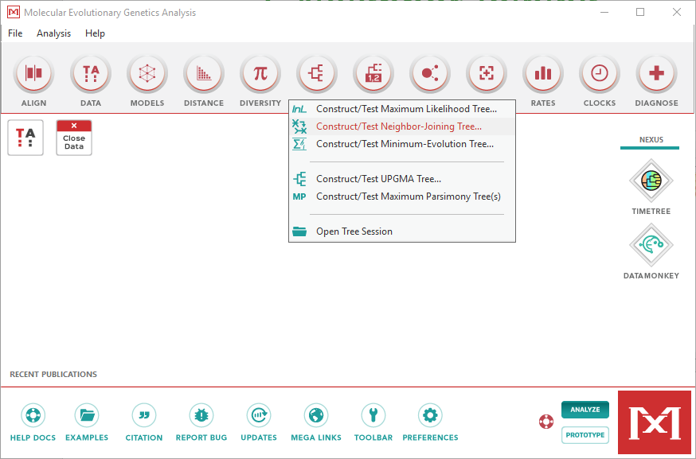
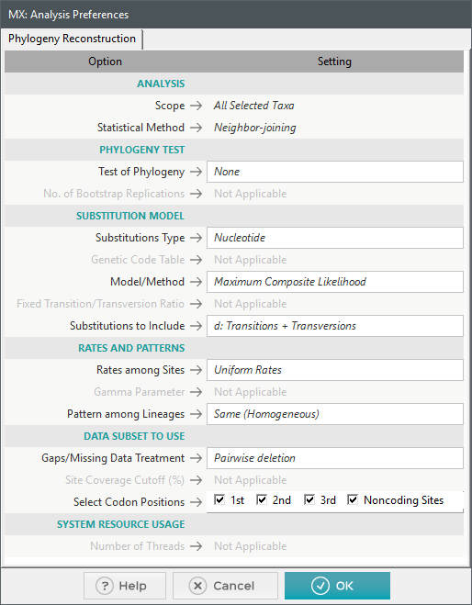
3. Neighbor Joining
Substitutions type should be the type of our sequence (Nucleotide or AminoAcid)
Notes:
Defaults options for Neighbor Joining are ok but if we want to use a more complex rate model, we can change from “Uniform rates” to “Gamma distributed”(4) and Patter among Lineages to “Different”

Slide 20
3. Maximum Parsimony
Properties
Uses
It is based on Ockham's razor, i.e. the simplest tree (with the least amount of mutations) is the best one.
Fast.
Can be used for exhaustive search.
It is more accurate and but it is not statistically robust.
Can be used to make trees of closely related species. Its accuracy decreases the more distant the species are.
It has fallen out of grace in molecular biology but is still widely used with morphological data.
Notes:
Although maximum parsimony trees are better than Neighbor joining and can be published, it is advisable to use maximum likelihood trees.

Slide 21
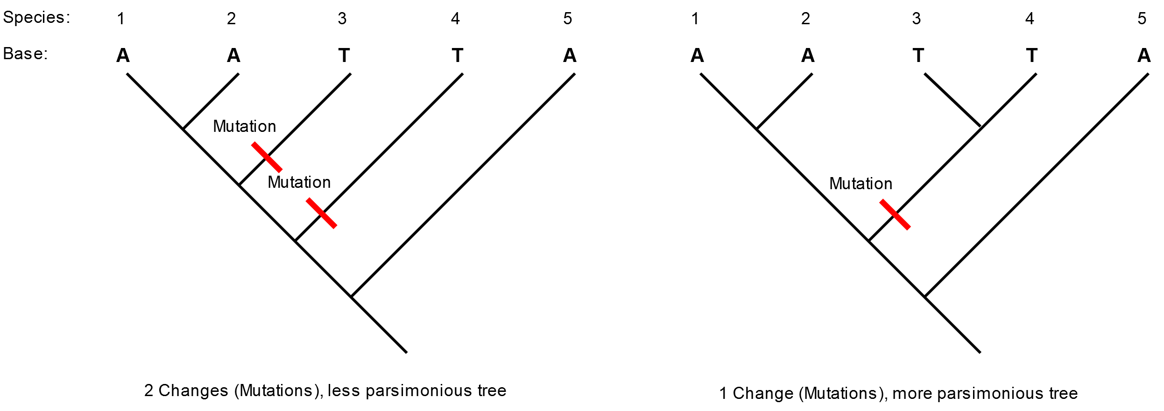
3. Maximum Parsimony

Slide 22
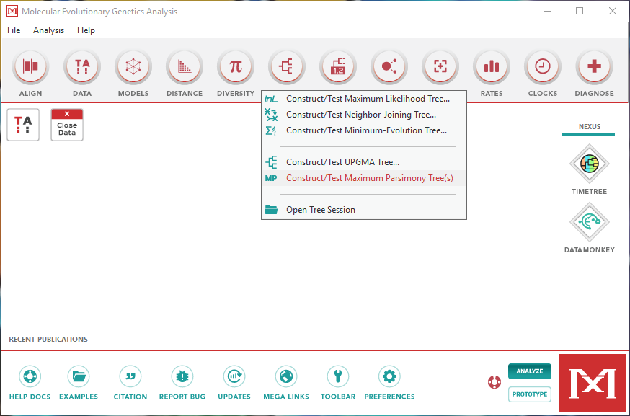
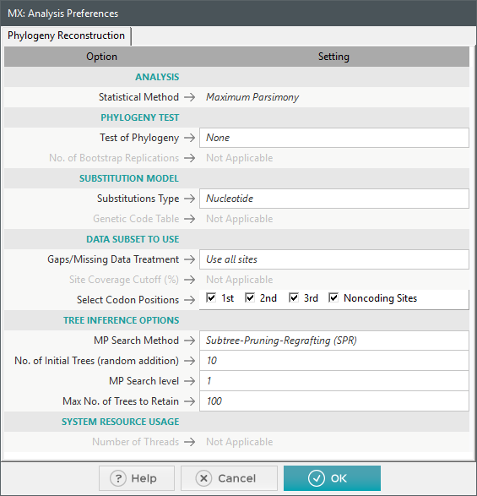
3. Maximum Parsimony
Substitutions type should be the type of our sequence (Nucleotide or AminoAcid).
We can also change the search method. SPR and TBR are heuristic, Branch & bound is exhaustive
Notes:
Branch & bound is not exactly exhaustive but it will find the most parsimonious tree amongst every possible tree. It should only be used for small trees (<15 branches) since otherwise it will be very slow.

Slide 23
3. Maximum Likelihood
Properties
Uses
It calculates the likelihood of our sequences happening given a tree and a model of evolution.
Slow (depends on the model).
Has several hypothesis of evolution.
It is accurate and statistically robust.
Can be used for both close and distant species.
One of the most popular methods at the moment.
Very robust, it can give us a good tree even if our model of evolution is not the best one.
Also used for morphological characters.

Slide 24

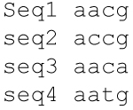
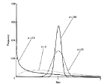
3. Maximum Likelihood
Model
(
)
Probability of
given
Our model is composed of a tree and a model (base composition and base substitution rates)

Slide 25
3. Maximum Likelihood
Composition
Substitution
How often do we expect to see each base?
It is a vector
It can be different for different organisms (think high GC)
Example: Gene 1 = ga
p(g) = 0.4; p(a)=0.15 (for instance)
likelihood(ga) = 0.4 x 0.15 = 0.06
What is the chance of a base to be replaced for another?
It is a matrix
For example some models consider more usual for A to be replaced by T than by C or G.
Notes:
Although maximum parsimony trees are better than Neighbor joining and can be published, it is advisable to use maximum likelihood trees.

Slide 26
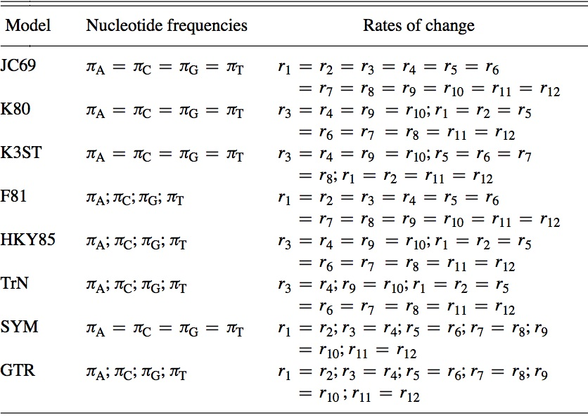
3. Maximum Likelihood
Every model assumes how the evolutionary process works.
From very simple (all rates are equal) to very complex models.
How do I choose a model?!

Slide 27
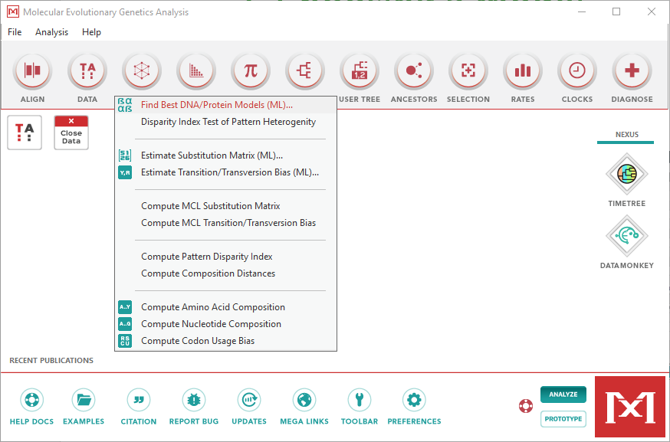
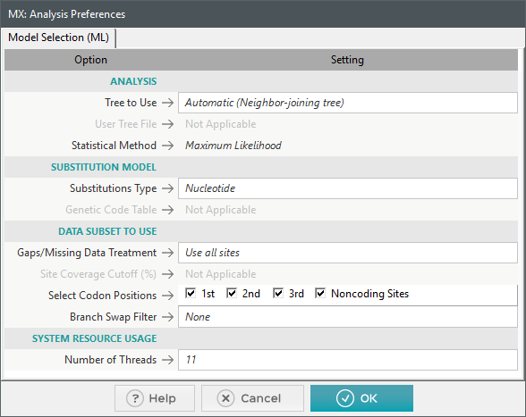
3. Choosing a model
Substitutions type should be the type of our sequence (Nucleotide or AminoAcid).
Number of threads indicates how many CPUs the program will use, the more the faster.
Notes:
The program usually provides the maximum number of threads your computer can use. If you are unsure how many you can use, using just 1 or 2 is fine but it will be slow.

Slide 28
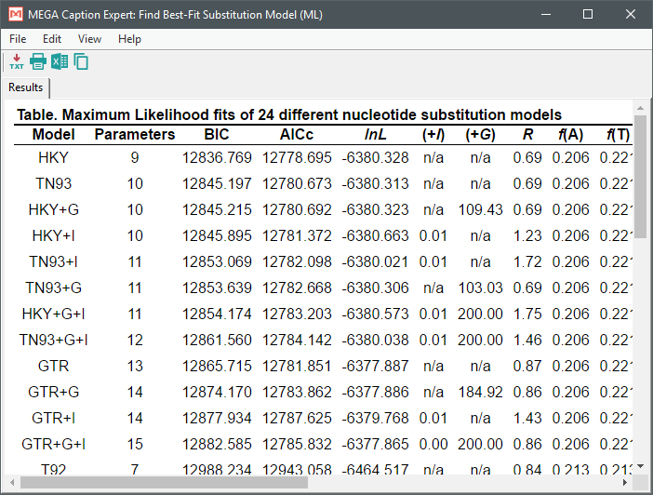
3. Choosing a model
BIC and AICc are goodness of fit criterions used to compare between models.
The lower the number, the better.
MEGA shows the best model on top.

Slide 29
3. Choosing a Model
What is +I?
What is +G?
Indicates that our sequence has a proportion of invariable sites.
Conserved sites under selective pressure.
Related to function or structure.
Calculates the likelihood of a site being invariable.
For variable sites, they can be under different selective pressures so they are substituted at different rates.
Uses a continuous distribution (Gamma distribution) to account for this.
High impact to performance.

Slide 30
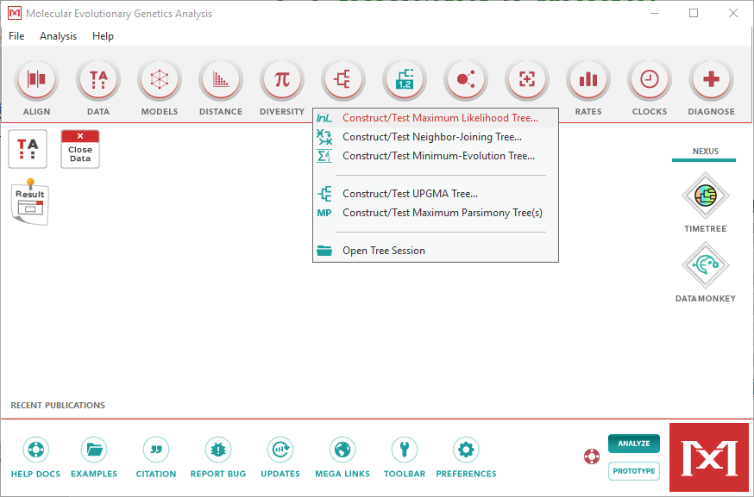
3. Maximum Likelihood

Slide 31
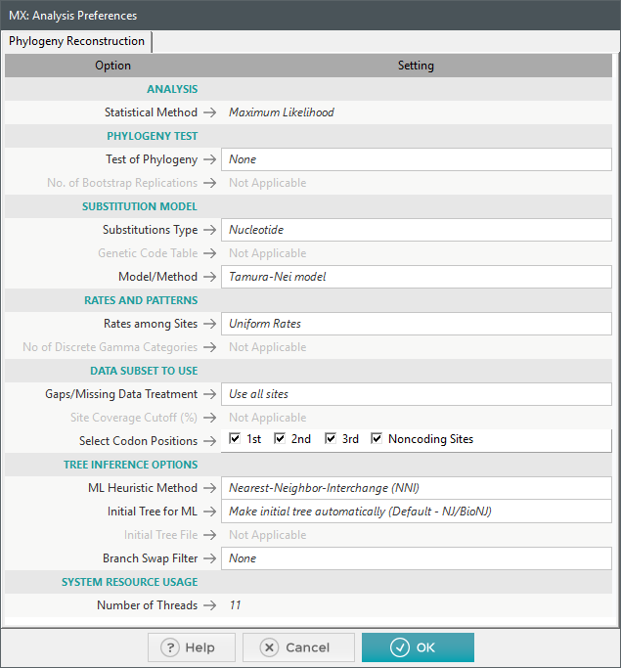
3. Maximum Likelihood
Nucleotides or AminoAcids
Change to our model
Select +I, +G, +I+G or Uniform rates depending on the chosen model.
4 Gamma categories is a good number.

Slide 32

3. Bayesian inference
Properties
Uses
Based on Bayes’ Theorem.
Calculates the likelihood of a tree given our sequence.
Fast
Has several hypothesis of evolution.
It is accurate and robust.
It is the other popular method used at the moment.
More efficient than maximum likelihood.
Different than previous methods, present in advanced programs. More complex to use correctly.
Notes:
An in-depth guide of Bayesian inference can be found at https://www.ncbi.nlm.nih.gov/pmc/articles/PMC5624502/ . This paper also mentions programs used for Bayesian inference.

Slide 33
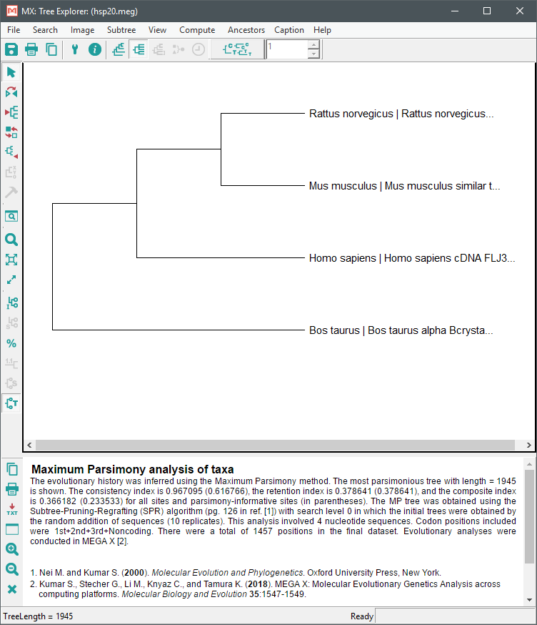
3. Finally, a tree
The final result of all the methods discussed in the lecture.
We can format the tree in this window, or save it for other programs.
Newick format is recommended, widely used.

Slide 34
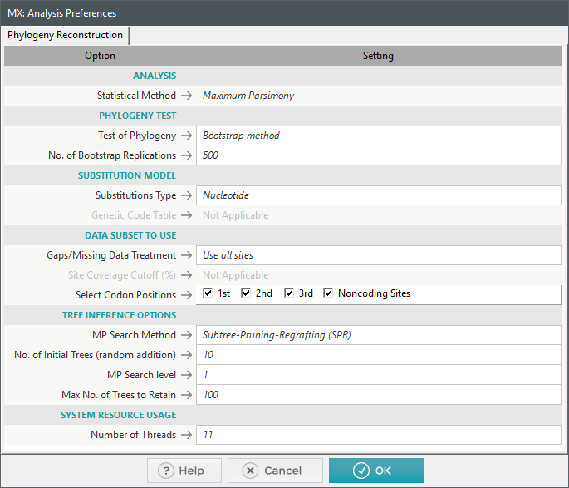
3. Testing our tree
We use Bootstrap to get the confidence level of each branch split, basically how well supported by the data every branch is.
Used by all the methods discussed in the lecture except Bayesian.
Usually between 100-1000 iterations depending on the size of the tree.
Notes:
In MEGA, the Bootstrap analysis will be done along with the tree. However it will make the process much more slower. Other programs allow to make bootstrap analysis of an already calculated tree.

Slide 35
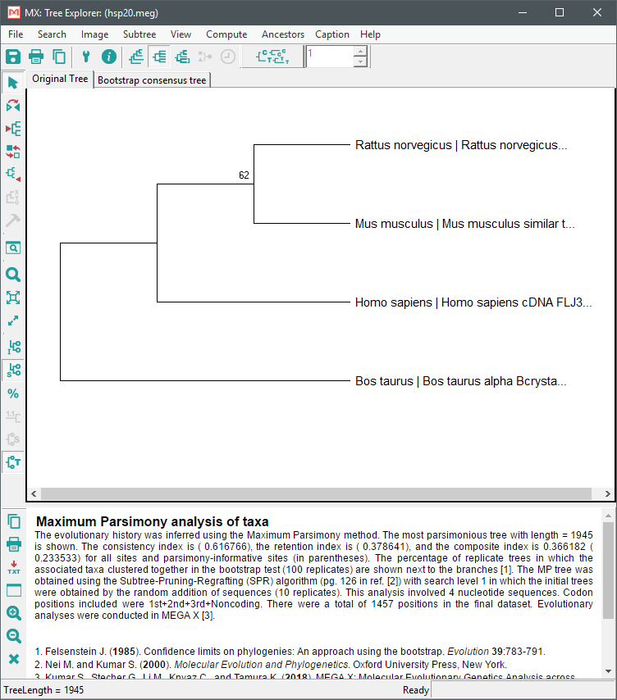
3. Testing our tree
In this case, 62% of the bootstrap trees agree with our tree for this branch split.
We should try to aim for >80 support in every branch split.
Notes:
In MEGA, the Bootstrap analysis will be done along with the tree. However it will make the process much more slower. Other programs allow to make bootstrap analysis of an already calculated tree.

Slide 36



3. Making our tree pretty
Import our tree in newick format to other programs.
FigTree (Online)
Notes:
FigTree (https://github.com/rambaut/figtree/releases) Very easy to use, makes good looking trees.
Dendroscope (http://dendroscope.org/) Good for comparing trees.
ITOL (https://itol.embl.de/). ITOL offers much more than just formatting trees, and we can also see trees made by other people. Available online, also makes very pretty trees.

Slide 37
Phylogenetics
Basics of Phylogenetics
Cladogram, phylograms, rooting, outgroups
Data and Alignment
What kind of data to use, aligning our sequences
Phylogenetic Analysis:
Neighbor joining
Parsimony
Maximum likelihood
Testing

Slide 38
Other programs and tutorials
Command Line (Changing directories and checking files)
Complete Packages: SeaView, PAUP
Alignments: ClustalW, MUSCLE, Mafft
Model Testing: JModelTest, ProtTest, ModelGenerator
Maximum Likelihood: RAxML, PhyML, IQ-Tree
Bayesian inference: MrBayes, BEAST, PhyloBayes, RevBayes
Notes:
SeaView is old and not so used anymore but it is available in the University computers. It may lack some of the features of MEGA.
PAUP is a program that uses a command line like interface, but allows us to do a complete phylogenetic analysis, including Neighbor Joining, Parsimony, Maximum Likelihood, model testing (DNA only) and Bayesian. It is popularly used for morphological data trees.
All the alignment programs have online versions that allow you to paste sequences and get an aligned file. All of them work fast and are good for alignments, you can test aligning with several of them. My personal preference is Mafft.
JModelTest and ModelGenerator can test for both DNA and Proteins. ProtTest is used for protein models but includes more complex and recent models, best paired with RAxML.
PhyML and RAxML can only do a maximum likelihood analysis, both are very fast. I personally prefer RAxML. IQ-Tree also offers model selection in addition to maximum likelihood, also fast, it has become really popular lately.
Both Bayesian programs are good for Bayesian inference but MrBayes is popular and easy to use. PhyloBayes has a good model of evolution, harder to use. RevBayes allows you to modify the evolution model.

Slide 39
Thank You!
We would like to say a big thank you to the Division of Evolution and Genomic Science for supporting this series, and all of you for attending!
Please join us for drinks and chat in the café!
And follow us on twitter - @EGS_UoM

